Slide 1

Determining What Kind of Customers are More likely to Purchase a Health Plan
Team 4
Project 2

Slide 2

Outline
STEP 1
Big Picture
STEP 2
Build Model
STEP 3
Analyze Results
Study Goal
Target Variable
Input Variables
Test for Significant Predictors
Perform Cross-Validation
Interpret Results
Recommendations

Slide 3
Survey Data
Age | Interval | Age, as of 1979
Urban | Binary | At the age of 14, respondent lived in: 1 - Urban area 0 - Non-urban area
Mother_Edu | Interval | Number of years of mother’s education
Income | Interval | Income in 2000
Siblings | Interval | Number of siblings in 1979
Black | Binary | 1 - Black 0 - Non-Black
Christian | Binary | As of 1979, 1 - Christian 0 - Non-Christian
Height | Interval | Height in inches in 1981
HealthPlan | Binary | Covered by health insurance/ health care plan in 2000: 1 - Yes 0 - No
……………. | ……………. | …………….
Goal: Identify what makes an individual more likely to purchase a Health Plan
Basic Data Observations:
Each row is defined by a unique ID, 12,686 rows in total
24 Different Variables
Mixed data (binary + interval)
Target Variables:
Bin 0: Buy the health plan
Bin 1: Do not buy the health plan

Slide 4
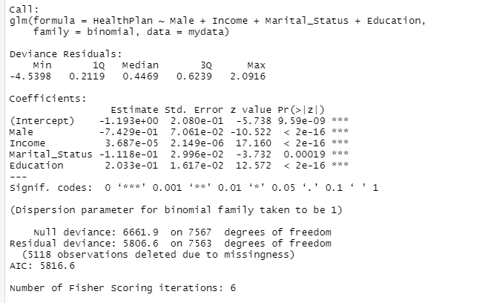
Logistic Regression
After performing logistic regression and observing all the variables’ p value, we found only 4 variables were statistically significant in predicting the target variable
These include:
Male
Income
Marital Status
Education
Notes:
statistical model that models the probability of an event taking place by having the log-odds for the event be a linear combination of one or more independent variables.

Slide 5
How Gender impact Health Plan purchase
The odds of health plan purchase decrease by 52.43% for every one unit increase in male customer
Parameter | Exp(Est)
Gender | -0.7429
The odds of health plan purchase decrease by 47.57% for every one unit increase in female customer
More female customer
More potential purchase

Slide 6
How income impact health plan purchase
Parameter | Exp(Est)
Income | 3.687e^-05
The odds of health purchase increases by 0.0037% for every one unit increase in income.
We can infer that income doesn’t really have that much effect impact on the decision of purchasing a health plan.

Slide 7
How marital status impacts health plan purchase
Parameter | Exp(Est)
Marital Status | -0.1118
The odds of health plan purchase increase by 10.57% for every one unit increase in married individuals
The odds of health plan purchase increase by 89.43% for every one unit increase in single individuals
More focus on singles
More potential purchase

Slide 8
How education impacts health plan purchase
Parameter | Exp(Est)
Education | 0.2033
The odds of health plan purchase increase by 22.54% for every one unit increase in educated individuals
More educated individuals
More health plan purchase

Slide 9
Interesting Finds
Female customers can be the potential target customers since the odds of purchasing the health plan decreased by lesser percentage when compared with male customers
Another interesting inference was that income did not really have that much significance in terms of its impact towards health plan purchase
Lastly, educated and single individuals can be also potential targets since they showcased higher odds of health care plan purchase

Slide 10
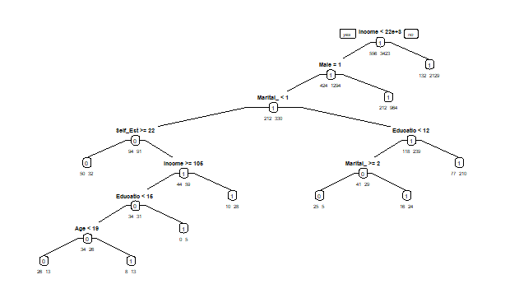
Decision Tree
We can conclude from this model that the people that will be more likely to be under a health plan are:
Females with an income greater than $22,000
Unmarried males with an education that is higher than a high school diploma (12 years)
Males with income less than 106 and age greater than 19

Slide 11
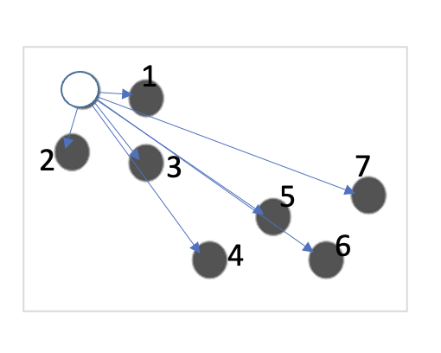
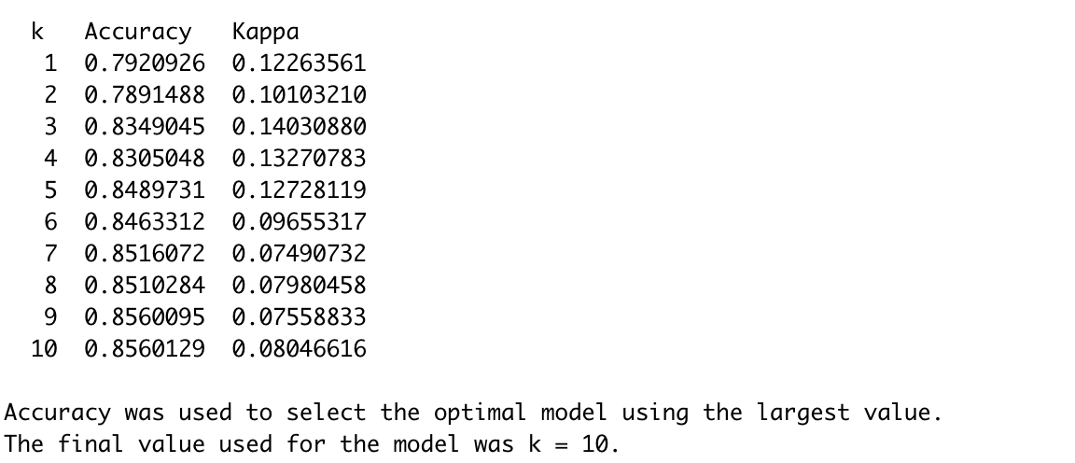

K-NN Model
K-Nearest Neighbors (K-NN): a non-regression based supervised data mining method for relationships and predictions.
10-fold cross validation with 60:40 data partition

Slide 12
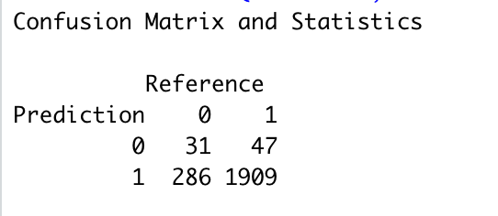
K-NN Model
Sensitivity = % of Positives cases that are correctly predicted.
A high sensitivity indicates that this K-NN model is accurate in predicting new customers who will purchase the health plan.
Specificity =% of Negatives cases that are correctly predicted.
A low specificity indicates that this K-NN model performs poorly in predicting customers who will not purchase the health plan
Accuracy | 0.8535
Sensitivity | 0.9759
Specificity | 0.0977
Notes:
Recommendations: We could use the K-NN models for predicting if the potential customers will buy the health plan. By calculating and using the nearest 10 neighbors’ response as prediction, we could gain 97.59% accuracy. We could use K-NN model to define our target customers and marketing to them specifically.

Slide 13
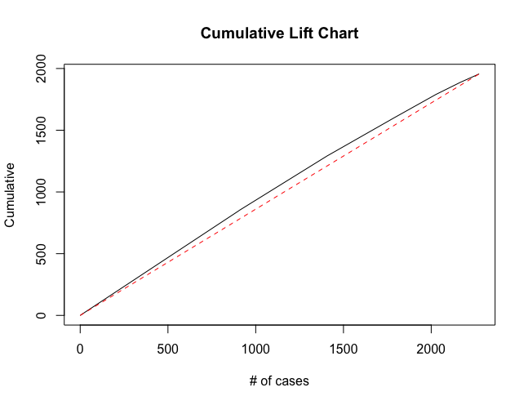
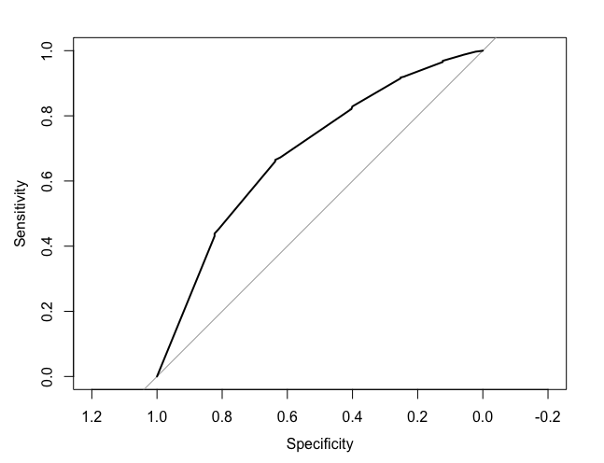
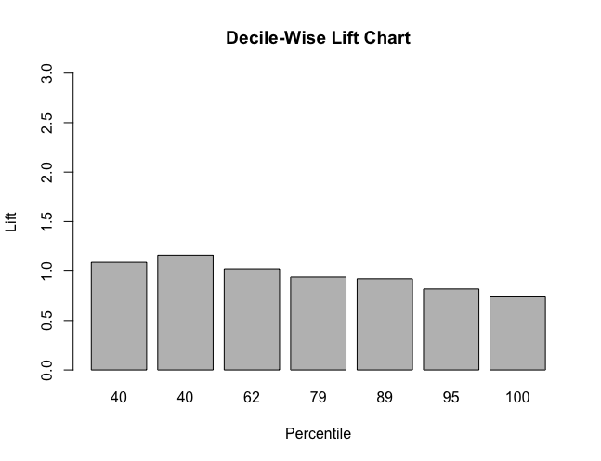
Classification Performance Diagram of K-NN Model
Area under the curve: 0.6881
K-NN Model is more accurate than the baseline model!

Slide 14
Recommendations
Focus on this people who have the following characteristics:
Females with an income greater than $22,000
Unmarried males with an education that is higher than a high school diploma (12 years)
Males with income less than 106 and age greater than 19
We could use the K-NN models for predicting if the potential customers will buy the health plan. By calculating and using the nearest 10 neighbors’ response as prediction, we could gain 97.59% accuracy.
We could use K-NN model to define our target customers and marketing to them specifically.

Slide 15
Thank you!

